Slide 1

Unlocking Profits: Ranking Product Categories & Customer Segments
Presenter: Kushle Thaneshwar

Slide 2
Agenda
1. Problem Statement
2. Data Understanding
3. Univariate Analysis
4. Bivariate Analysis
5. Insights
6. Recommendations

Slide 3
Problem Statement
Businesses often struggle to identify which product categories generate the highest revenue..
Lack of clarity on high‑value customer segments makes marketing less effective
Inefficient inventory planning due to unclear category and seasonal trends.

Slide 4
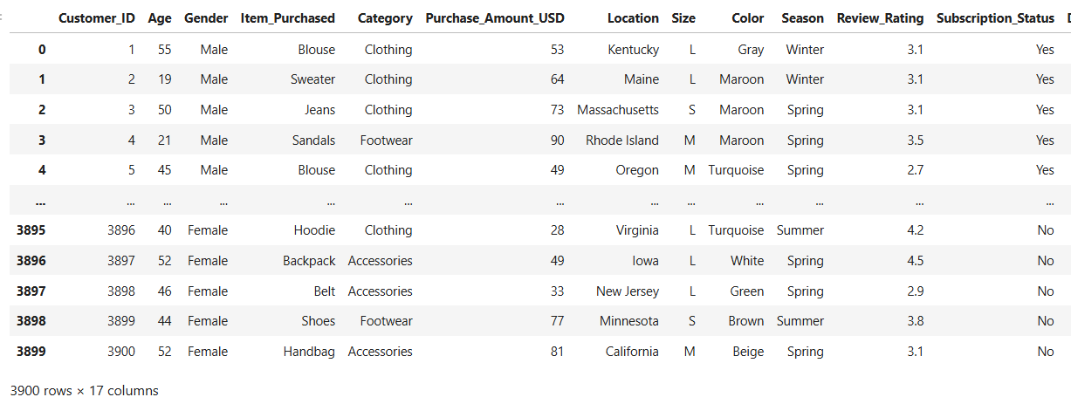
Key Features: Category, Gender, Age, Purchase Amount, Review Rating, Previous Purchases, Subscription, Payment Method, Season
Data Understanding
Source: Shopping behaviour dataset
Shape:3,900 rows × 16 columns)
Null values: 0
Duplicates Values: 0
Key Features: Category, Gender, Age, Purchase Amount USD , Season, Previous Purchases, Subscription, Payment Method.

Slide 5
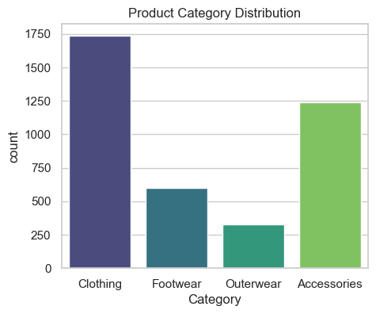
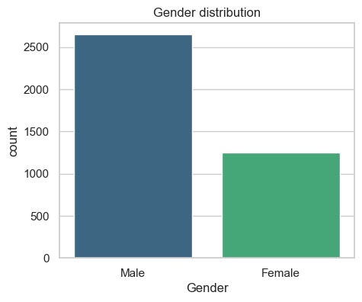
Univariate Analysis

Slide 6
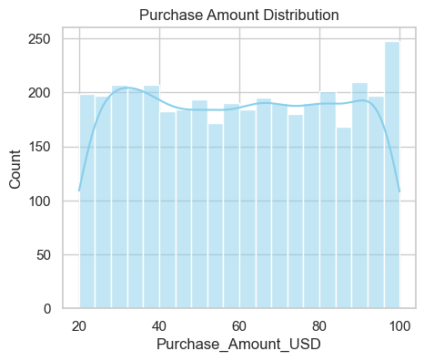
Histogram
Most purchases fall within a mid-range bracket, indicating a common spending pattern among customers.
The smooth curve (KDE) reveals the overall trend, helping identify typical purchase behavior and potential outliers.

Slide 7
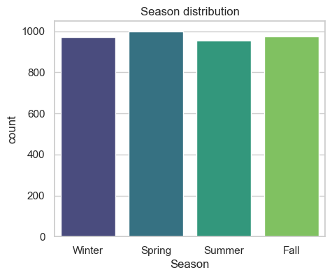
seasons show peak sales activity
Spring has the highest count, slightly above other seasons, indicating peak activity or engagement during that time.
All seasons show similar distribution, suggesting balanced seasonal performance with no major drop-offs.

Slide 8
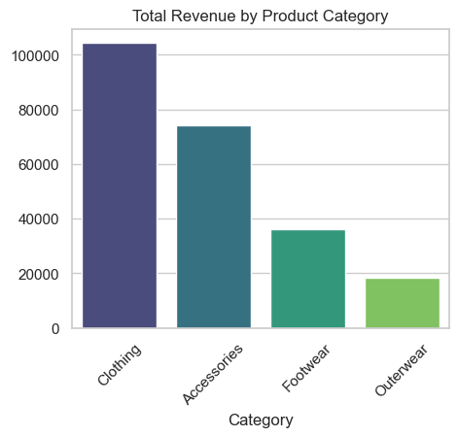
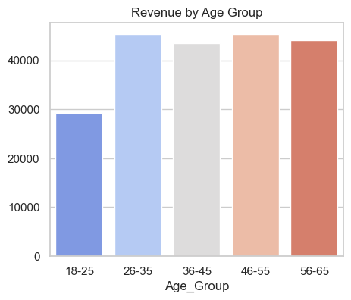
Bivariate Analysis

Slide 9
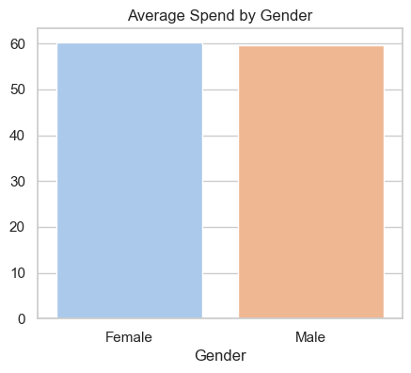
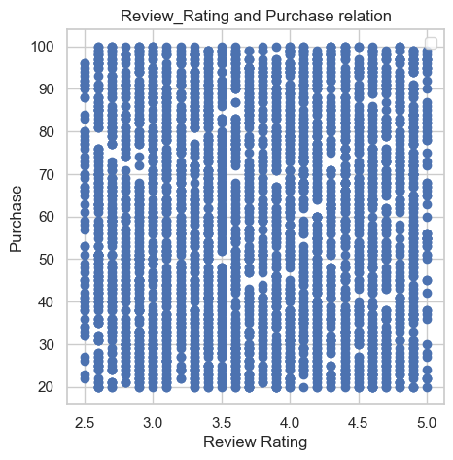
Bargraph and scatter plot

Slide 10
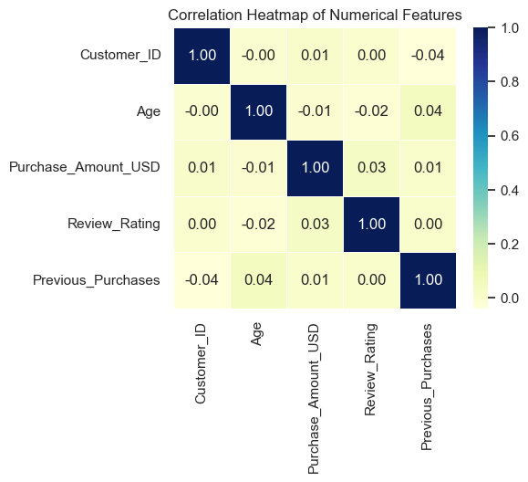
Heatmap: Correlation Between Numerical Features
Purpose → The heatmap shows how strongly numerical features are related to each other, with values ranging from -1 (negative correlation) to +1 (positive correlation).
Insight → By looking at the colors and numbers, we can quickly spot which variables move together (strong correlation) and which are independent (weak correlation).

Slide 11
Insights
Clothing & Accessories are the top revenue drivers
Age group 26–55 contributes the highest spending
Female customers spend slightly more per purchase than males
Winter & Spring seasons show peak sales activity
High review ratings correlate with repeat purchases

Slide 12
Recommendation
Focus on high‑revenue categories (Clothing & Accessories) for marketing and inventory planning
Target 26–55 age group
Engage female customers through loyalty programs and personalized offers
Plan inventory around seasonal peaks
Expected Impact: Applying these strategies can unlock ~20–30% profit margin.
12

Slide 13
Questions??

Slide 14
Thank you

